Slide 1
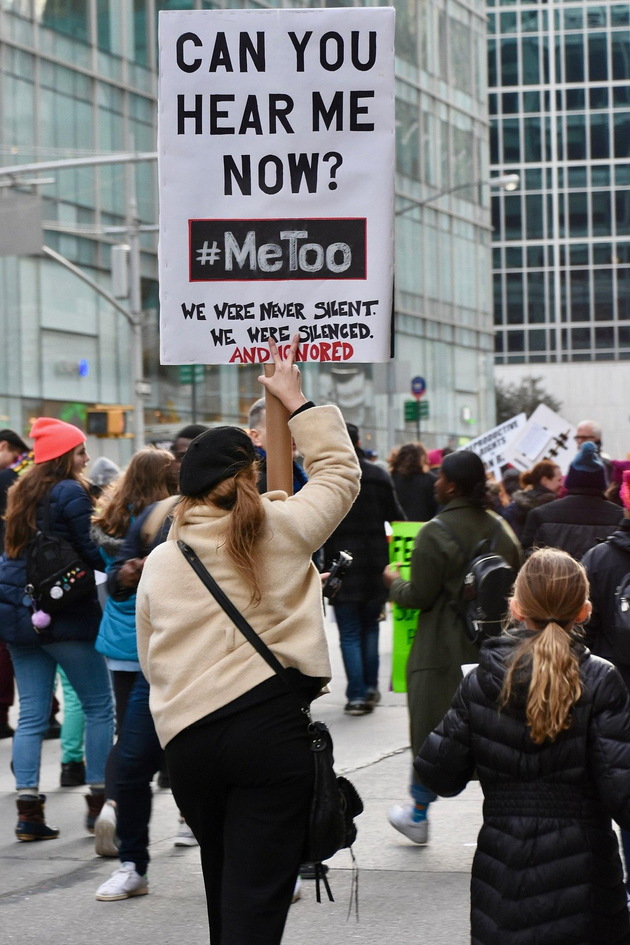
Snapshots of #MeToo: Analyzing Tweets During the Movement Peak and at a 2-year Follow-up
Pol 688 Final Presentation
Ali McCoy

Slide 2
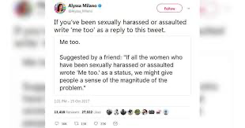
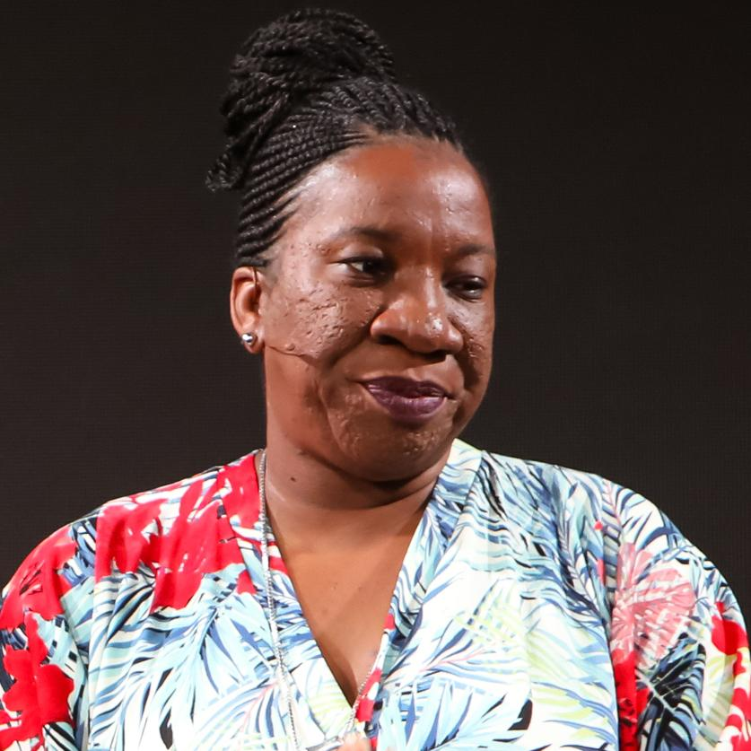

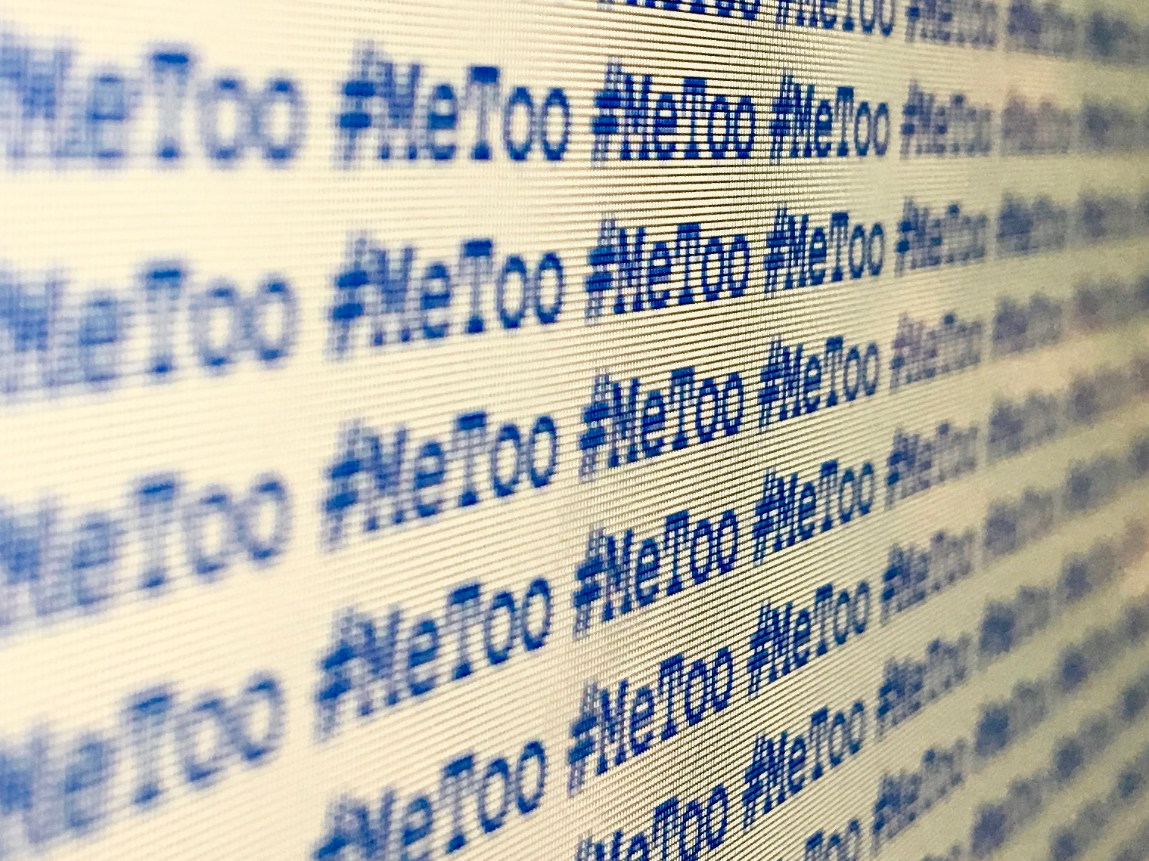
Background
What is the #MeToo Movement?
Tarana founded #MeToo Movement in 2007
Didn’t gain traction until Alyssa Milano’s 2017 post
12 million uses of hashtag 24 hours after Milano’s post
Hashtag created a cross-cutting network of individuals
Notes:
The #MeToo movement was officially founded in 2007 by activist Tarana Burke, who originally used the phrase “me too” to convey solidarity among victims of sexual violence (Alexander 2020). However, the movement did not attract mass mainstream attention until ten years later in 2017 when actress Alyssa Milano encouraged anyone who had ever experienced sexual harassment to use the hashtag “#MeToo.” Within twenty-four hours of Milano tweeting the hashtag, there were over 12 million uses of the hashtag on Facebook alone (Glover 2017).

Slide 3
Existing Research on #MeToo Tweets:
Author(s) + year | Data | Method | Results/sig
Drewett, Oxlad & Augoustinos, 2021 | 10546 #Metoo tweets from Oct 16 2017 | Conventional content analysis | 3 trends of tweet categories: self-disclosure, messages of support, & calling out poor behavior₁
Modrek & Chakalov, 2019 | 11935 #Metoo tweets from Oct 14-21 2017 | machine learning methods, least absolute shrinkage and selection operator regression, and support vector machine models to summarize and classify the content of individual tweets | Tweets shared went beyond acknowledgement of having experienced sexual harassment and often included vivid and traumatic descriptions of early life experiences of assault and abuse. ₂
Hosterman et al., 2018 | 27803 #Metoo tweets from Oct 18 2017 to March 15 2018 | Hand coded content analysis | Created coding scheme for types of tweets: emotional, informational, directives, appraisal, other– found that informational was used most.₃

Slide 4
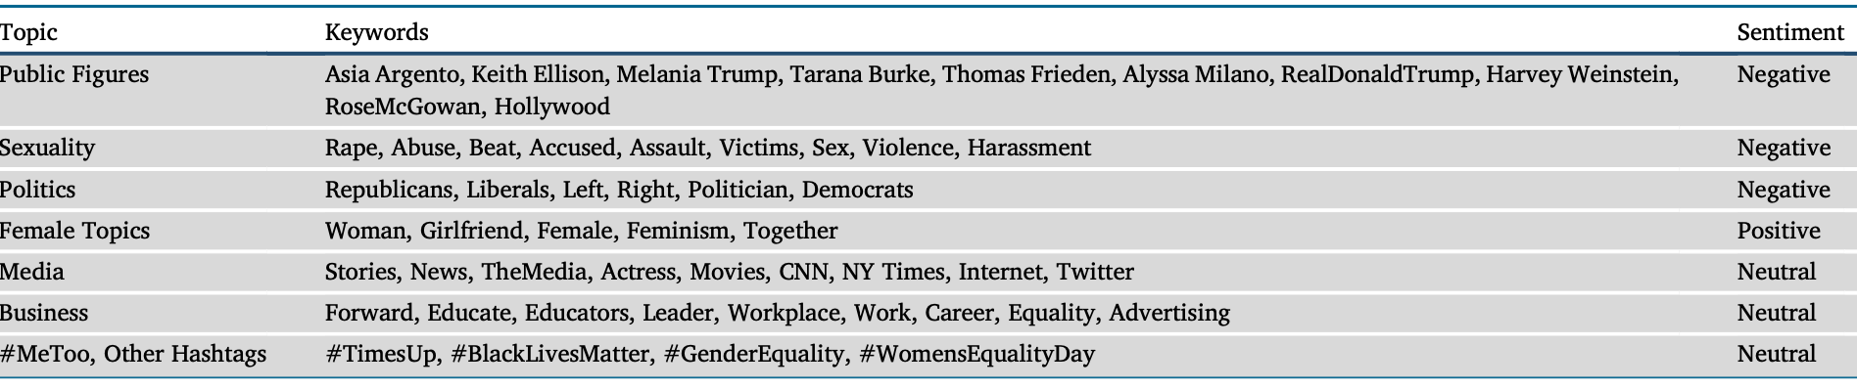
What about Sentiment Analyses on #MeToo Tweets?
Far less peer-reviewed publications Looking at sentiment:
In a paper focused marketing challenges during the #MeToo era, authors used a Supervised Vector Machine (SVM) analysis to classify for sentiment₄
In another paper looking at #MeToo tweets from the 24h time period after the hashtag gained traction, authors hand coded for sentiment and found that while the overall sentiment indicated a negative tone, the majority of positive social reactions indicated validation and belief of survivors, offered emotional support and called for social change.₅

Slide 5
My Goal:
How Did #MeToo and the discourse around it fade out over time?
Updated RQ: What were the most common words and sentiments of #MeToo tweets at two different timepoints in the online movement– the onset of virality (Oct 2017) and two years from popularity (Oct 2019)?
While this question is MUCH more narrow than my original midterm proposal, I believe this provides an important starting place for content and sentiment analyses that can be expanded onto other social media platforms and time periods.
Notes:
So, what is the goal of my project then? If you recall, for the midterm presentation, my proposed research question was: how did #metoo and the discourse around it fade over time?
However, keeping in mind the constraints of this course and data availability, I’ve narrowed down my question to be the following:

Slide 6
The Data:
Note: Since the Twitter API and related functions (i.e. Hydrator) are no longer accessible, I am limited to working with existing datasets
2 Different datasets illustrating different snapshots of the movement:
28K #MeToo tweets from Oct 2017
15K #MeToo tweets from Oct 2019
Data source: Kaggle
Limitations: No control over data collection, limited snapshots (no 2018 data), differing sample sizes, no account names/locations collected.

Slide 7
Data Cleaning For Text Analysis - tm package in R
mutate data frame into a Corpus for text analysis
Create subset of data that removes “#MeToo”
Cleaning the tweets themselves:
Removed capitalization
Removed punctuation
Removed numbers
Removed stopwords ← the, of, and, or, etc.
Removed URLs
Created a function
Created a document matrix to run content analysis
Notes:
Since #MeToo was the search term in both of these datasets, every tweet includes the hashtag and needs to be removed in order to make for a more meaningful content analysis

Slide 8
Top Tweets- Favs
Top Tweets ‘17 | Favorite count | Top Tweets ‘19 | Favorite count
To everyone who has come forward with #MeToo, thank you for your courage. To all survivors, know that you are not alone. | 12646 | bombshell looks so good until you realize it’s entirely directed and written by men and it only exists because studios are trying to capitalize off #metoo | 2379
A moment can create a movement. This is our moment. This is our movement. #MeToo | 12173 | Months before #MeToo broke us wide open, a man tapped me on the shoulder at a restaurant and said he had read this op-ed I wrote, was moved, and wanted to talk. | 2080
Completely fucking horrified by the amount of women I know, love & respect tweeting #MeToo. | 10785 | During this time of MeToo, it is also very very very very very very very very very important to teach young girls that making false accusations is very very very very very very very very very bad and they should not weaponize sexual assault allegations. How can we do this? | 1805
Kamala Harris →
Alyssa Milano →
Eric Kripke (Writer for Supernatural & The Boys) →
Notes:
Before taking a deeper look into the content and sentiment of the tweets, I want to look at which tweets are the most popular, what the content looked like there, and what the rates were for those top tweets:
By just looking at these 6 tweets we can’t make any lofty claims, but I do have a few initial thoughts before digging further into the data.
The 2017 tweets are more general in support to the movement and saddened by the amount of others using the hashtag
2019 tweets more mixed, contextualised, and we even have a top tweet that is talking about potential problems of the movement
Again, this could be an artifact of data collection, but the rate of likes in 2017 was substantially larger than in the 2019 sample, maybe signalling that there’s just less attention towards the movement at this time.
I also found that the most liked 2017 tweets were tweeted by famous people, where the 2019 tweets were either attributed to mostly regular accounts or deleted tweets that I couldn’t trace back

Slide 9
Top Tweets- RTs
Top Tweets ‘17 | Retweet count | Top Tweets ‘19 | Retweet count
A moment can create a movement. This is our moment. This is our movement. #MeToo | 2819 | Reminder that if a woman didn't post #MeToo, it doesn't mean she wasn't sexually assaulted or harassed. Survivors don't owe you their story | 51262
To everyone who has come forward with #MeToo, thank you for your courage. To all survivors, know that you are not alone. | 2711 | If a guy says he's nervous about #MeToo, just remind him that we come down pretty hard on murderers too, and ask him why that doesn't make him nervous. If he says, "Because I haven't murdered anyone," then you've learned something new about your friend. | 38413
Completely fucking horrified by the amount of women I know, love & respect tweeting #MeToo. | 2202 | Last night at the Trump rally in PA, a liberal protester touched me against my consent and said he'd throw me on the ground and rape me. Feminists around him, who say we're supposed to believe women, defended him and denied it happened. This is what the left has come to. #MeToo | 25320
Notes:
Is there a difference between top favorited tweets and top retweeted tweets? Lets take a look!
A bit of an aside: but that last 2019 tweet looked oddly familiar and upon some further digging it was actually originally tweeted by Kaitlin bennet aka “gun girl” who was popular on social media at the time for her ultra conservative takes.
The most favorited 2017 tweets are also the most retweeted, but when it comes to the 2019 tweets the trend is not the same. In fact there seems to be a bit of a flip flop in the frequency of retweets, where the 2019 dataset is seeing a lot more retweets (like upwards of 40k more in the first case) than the 2017 dataset

Slide 10
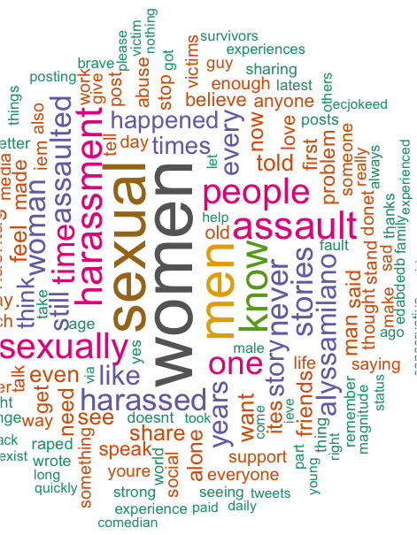
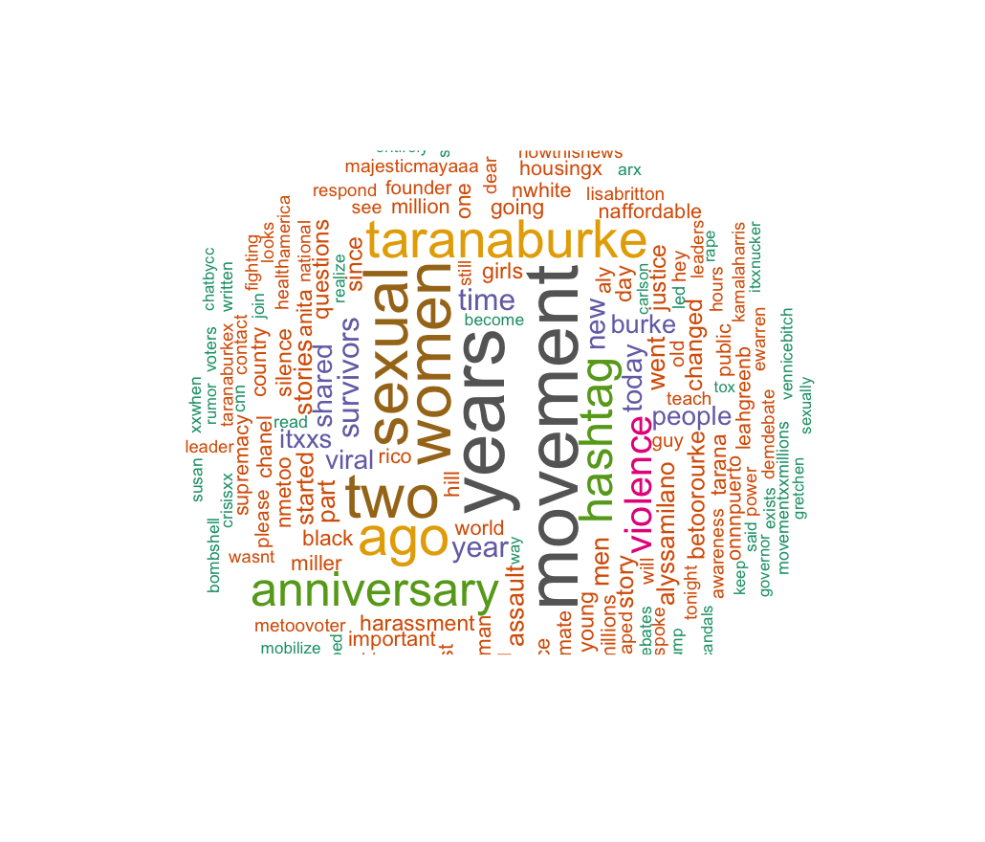
Visualizing the content of tweets - Wordcloud package in R
Word Clouds for the two samples:
2017
2019
Notes:
Looking for similarities: women, sexual, and diff violence leaning words
While these word clouds are interesting, they don’t really tell us much about the prevalence or sentiment of the content

Slide 11
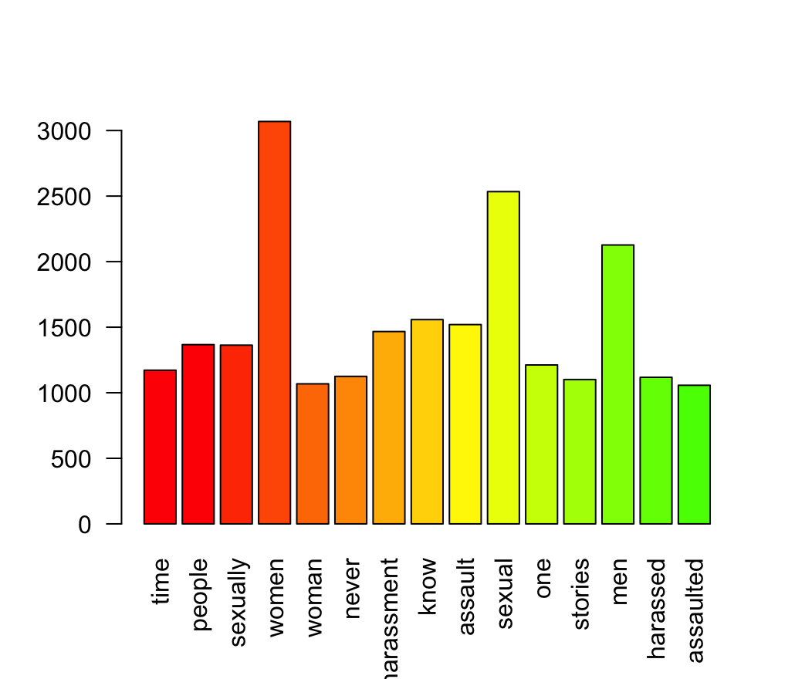
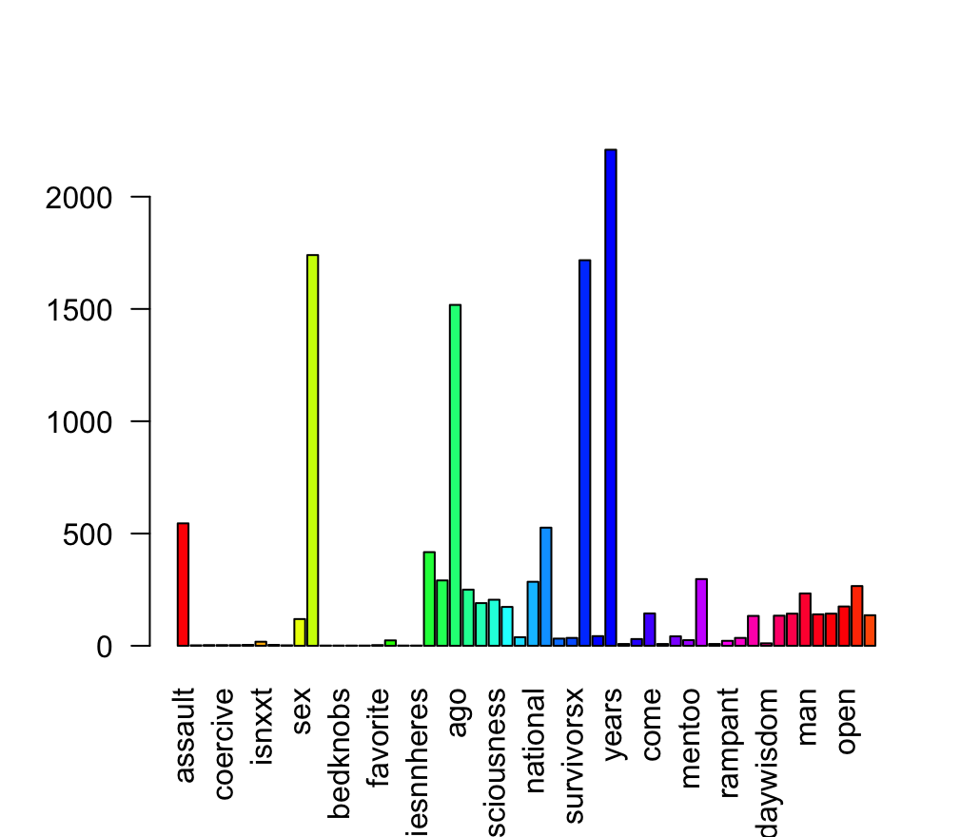
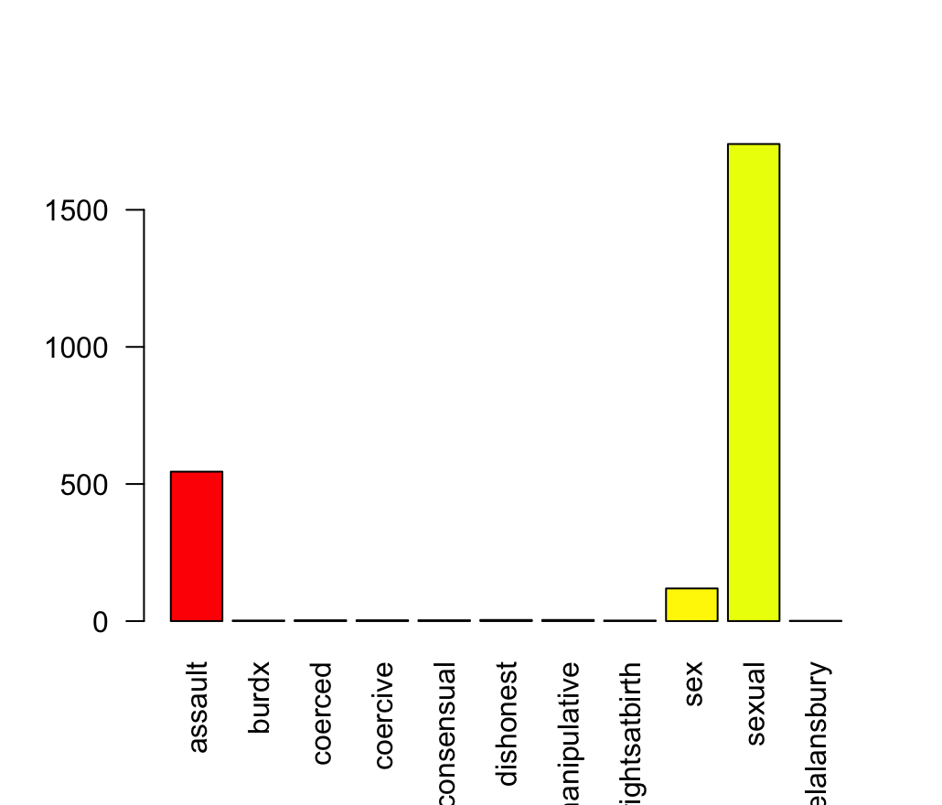
Further Breaking Down Most Used Terms
2017 Top words:
Women (>3000),
Sexual (~2500),
Men (~2000)
It looks like most of the tweets are disclosing some sort of sexual assault/harassment based on the top words used
2019 Top words:
Sexual (>1500),
Assault (~500),
Sex (~200)
It once again appears as though most of these tweets are disclosing sexual assault, with added nuance? (dishonest, coercive, consensual, manipulative)
2017
2019
Notes:
First, note that this is where we see the available data being a bit of a limitation. Since the 2019 dataset contains almost 15k less tweets, it’s hard to compare the most used terms on the same scale– as evident from the visual.
Nevertheless, here are some of the trends that I found:
For the 2017 dataset.

Slide 12
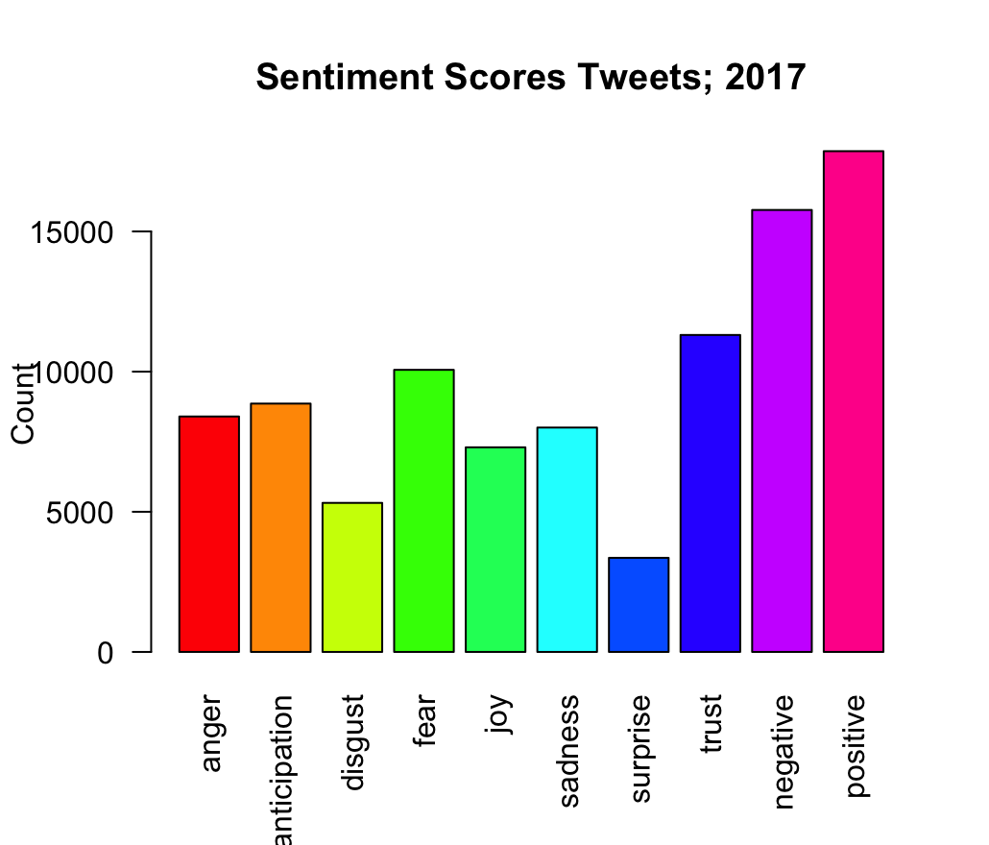
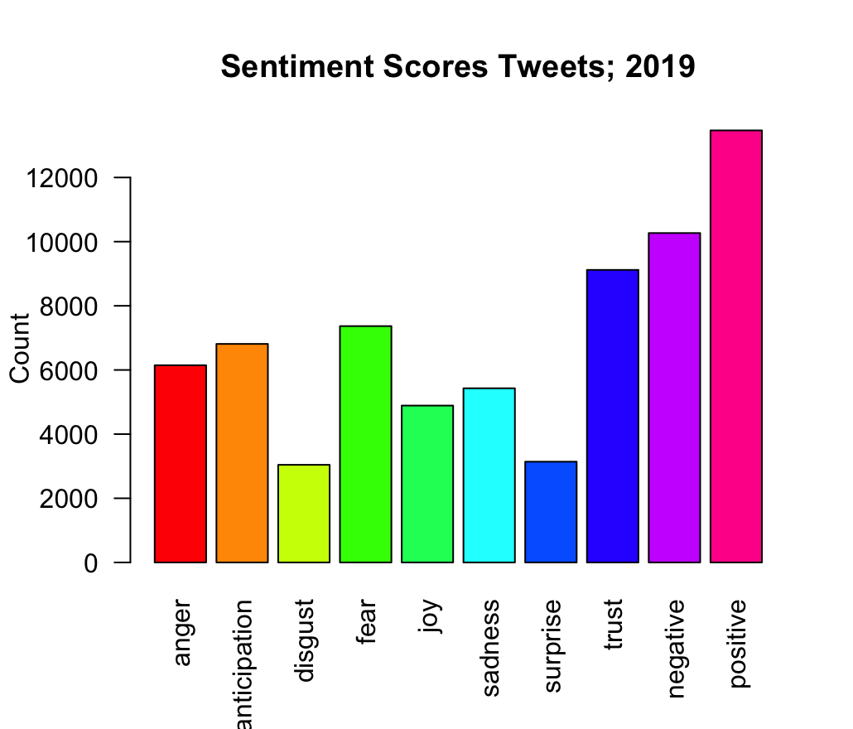
Sentiment Analysis - Syuzhet package in R
Notes:
NOTE: LOOK AT THE SCALES HERE, PROCEED W/ CAUTION WHEN INTERPRETING
While proceeding with caution, we can make some comments:
In both analyses, ‘trust’ seems to be the most tagged emotion
I’m thinking that this has to do with another popular hashtag at the time, #believe women, which was used as a political slogan arising from #metoo, also discourse during the movement about myths regarding rates of false accusations
Next in terms of most flagged emotion was fear, with ~10k tweets in the 2017 dataset and just over 7k tweets in the 2019 dataset – makes sense when we are dealing with a lot of disclosures of abuse.
In terms of the sentiment itself, we can see that there is almost the same rate of positive and negative tweets in the 2017 dataset, though in the 2019 dataset we actually see that there are far more positive than negative tweets (~2000).
However, I think it’s important to take pause here and think about why there are so many negative tweets. As we saw earlier when looking at the word cloud and most used terms/most popular tweets, we can see that a lot of these tweets attached to the hashtag are disclosing cases of sexual assault or harassment.
For example, in the Modrek & Chakalov (2019) piece that I mentioned at the beginning of the presentation, they found that in the 11k #Metoo tweets that they collected during the first week of the movement, that they included “ vivid and traumatic descriptions” of sexual abuse
Further in the Schneider & Carpenter (2020) piece looking at tweets in the 24h time period after the hashtag gained traction, the authors found that the overall sentiment indicated a negative tone and that the majority of positive social reactions indicated validation and belief of survivors, offered emotional support and called for social change
What does this mean for my project?
Perhaps a more nuanced hand-coded qual coding scheme to further tease apart the negative sentiment tweets in a few different categories; such as negative self-disclosure (they’re recounting something horrific that happened to them), negativity towards those accused, and negativity towards the movement itself.

Slide 13
Limitations and Future Directions
Main limitation: Data
Availability (RIP Twitter API)
Reliance on existing datasets
Snapshots of what I want to look at
Large differences in sample sizes
Scaling ← hard to make interpretable conclusions from present data
Future Directions:
Look towards other available social media platforms that have available data from 2017 - present on #MeToo
Hand code in a neutral category for sentiment analysis
Other recs to do with present data?

Slide 14
Works Cited
Drewett, C., Oxlad, M., & Augoustinos, M. (2021). Breaking the silence on sexual harassment and assault: An analysis of# MeToo tweets. Computers in Human Behav, 123, 106896.
Modrek, S., & Chakalov, B. (2019). The# MeToo movement in the United States: Text analysis of early twitter conversations. Journal of medical Internet research, 21(9), e13837.
Hosterman, A. R., Johnson, N. R., Stouffer, R., & Herring, S. (2018). Twitter, social support messages, and the# MeToo movement. The Journal of Social Media in Society, 7(2), 69-91.
Reyes-Menendez, A., Saura, J. R., & Filipe, F. (2020). Marketing challenges in the# MeToo era: Gaining business insights using an exploratory sentiment analysis. Heliyon, 6(3).
Schneider, K. T., & Carpenter, N. J. (2020). Sharing# MeToo on Twitter: Incidents, coping responses, and social reactions. Equality, Diversity and Inclusion: An International Journal, 39(1), 87-100.

